Slide 1
UPMC healthy living insurance
Team 14

Slide 2
Problem
Large and rising health insurance premiums
Single standard healthcare insurance rates
A System
Evaluate a client’s lifestyle

Slide 3
technologies
AWS Cloud : Amazon’s data center that offers computing resources and services
S3 Bucket : Storage for images
Rekognition : Recognition for images
Dynamo DB : Storage for data
Lambda Function: Connection of services
EC2 Instance : Server for users
Data Visualization : Highcharts.js

Slide 4




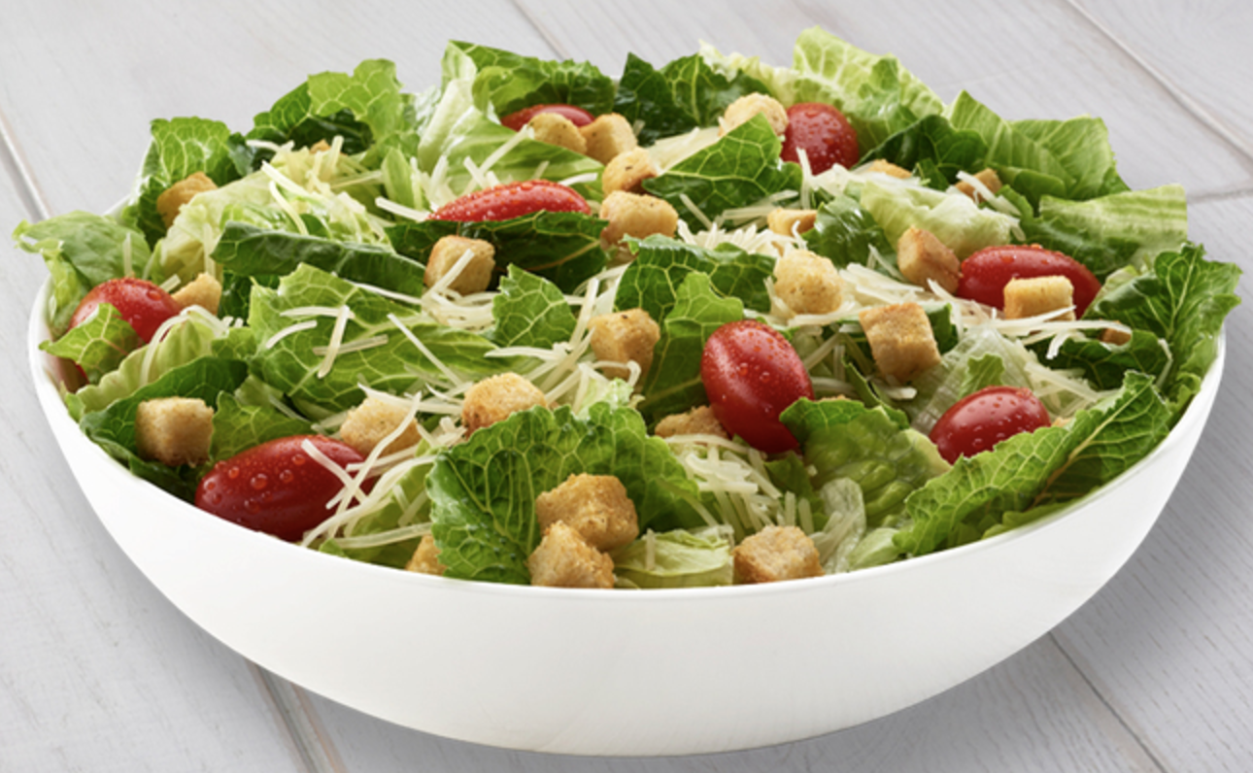
solution
Upload
Web Browser
Food Images

Slide 5
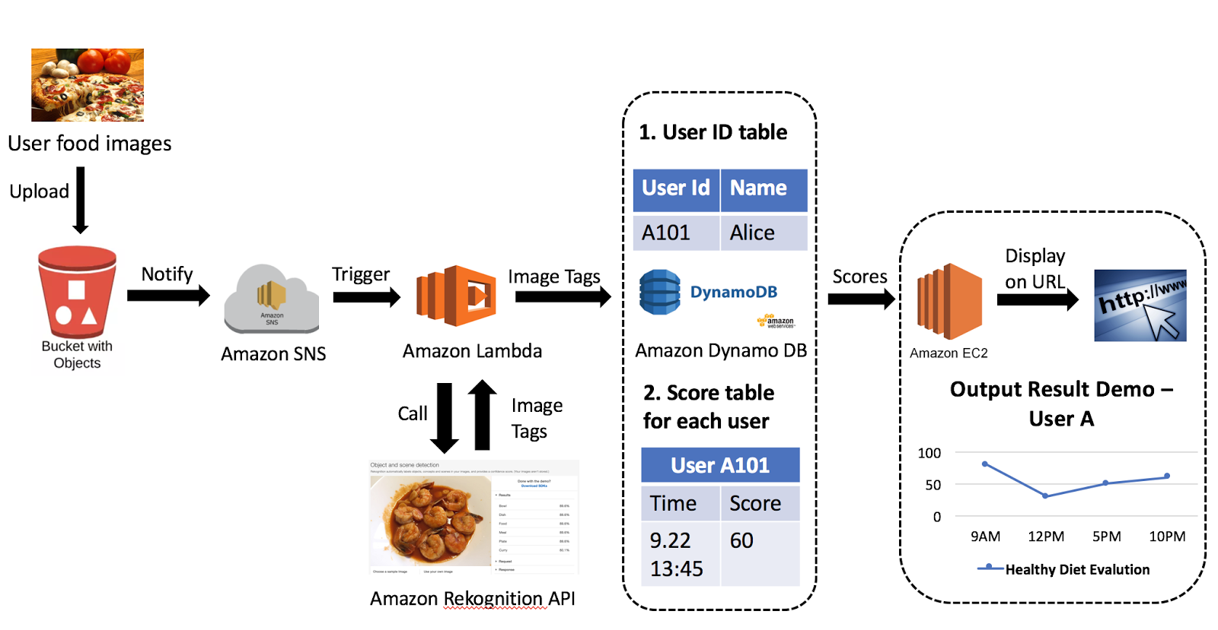
Architecture of the system

Slide 6
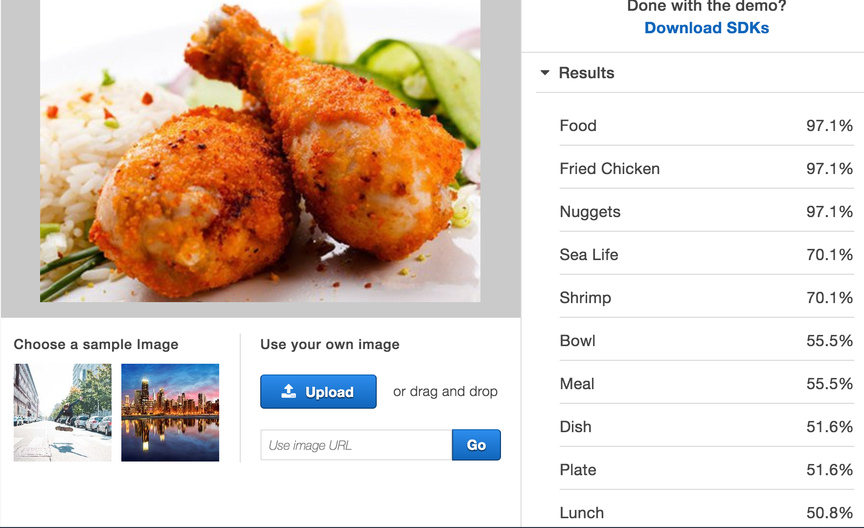
solution
Label | Score | Confidence | Product
Fried Chicken | 10 | 97.1% | 9.71
Nuggets | 10 | 97.1% | 9.71
Sea Life | 55 | 70.1% | 38.555
Shrimp | 55 | 70.1% | 38.555
Sum |  | 3.334 | 96.53
Score |  | 96.53 / 3.334 = 28.95

Slide 7


advantages
Safe & Robust
Permissions
Users with different authorities
Service with different roles
No physical devices
Fast
Automatically distributed resources
“Machines” with better performances

Slide 8
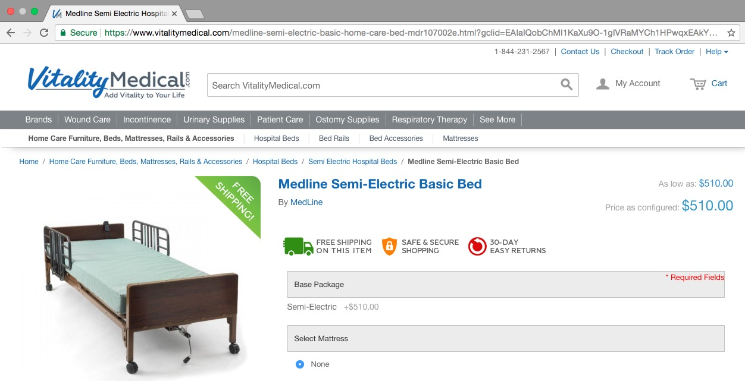
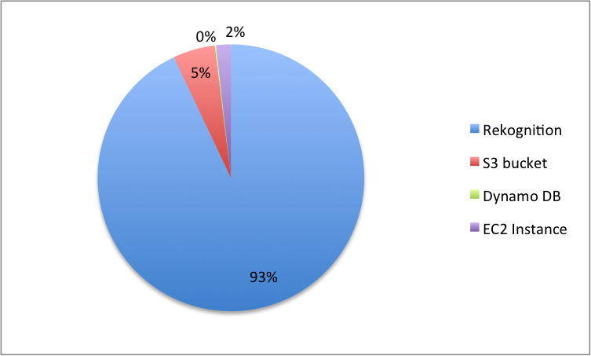
cost
$500
/Month

Slide 9


benefits
Convenient
Easy to use
Save time
Save training cost
Easy to deploy
Flexible
Easy to change functions
Easy to change scale

Slide 10
UPMC HEALTHY DIET EVALUATION SYSTEM
https://www.andrew.cmu.edu/user/zhiyuanz

Slide 11
Q & A

